Slide 1


2019
Department
Of Computer
Science
&
Electrical And
Electronics
Engineering
MATH-IV
KAS -402
2020-2021
Dr.Rupa Sharma
Associate Professor
vsrsrsys@gmail.com

Slide 3
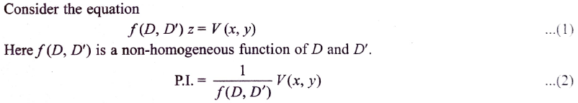
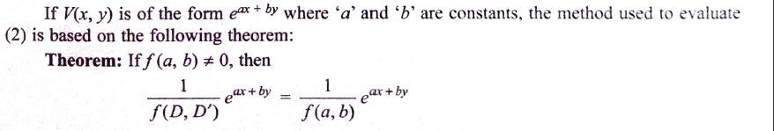
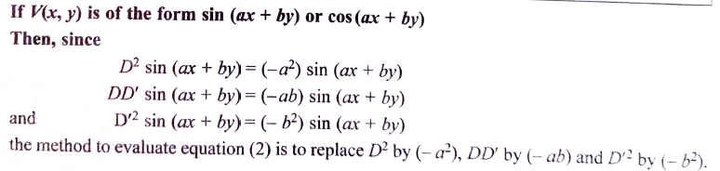
Case1 :
Case 2:

Slide 4
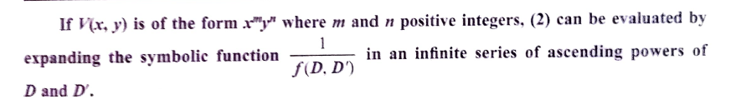


Case 3:
Case 4:

Slide 5

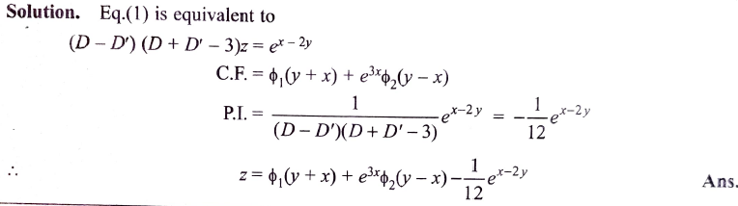

Slide 6
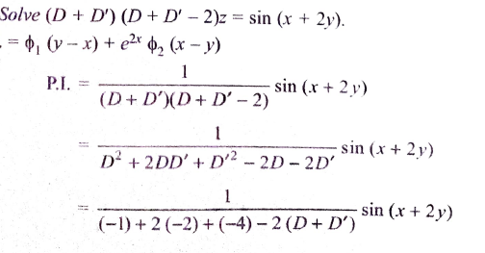

Slide 7
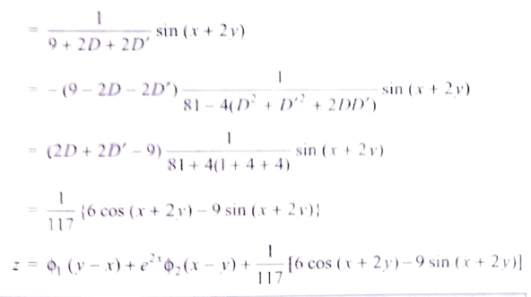

Slide 8
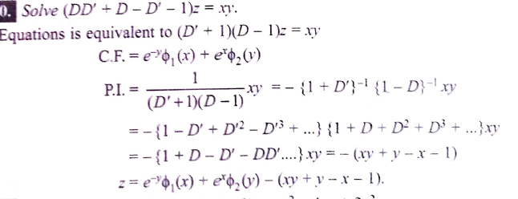

Slide 9
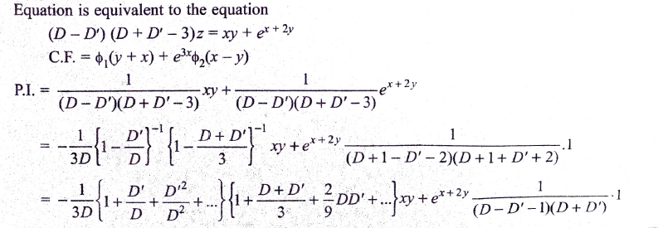

Slide 10
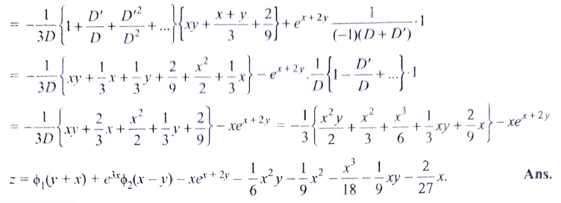

Slide 11
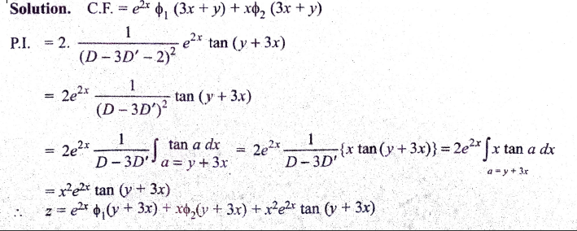

Slide 12
HOME Work

Slide 13
THANK YOU

